Slide 1
Methods Organization and Presentation
Samuel D.[Assistant professor of Epidemiology & Biostatistics]

Slide 2
Learning Objectives
At the end of this chapter, the students will be able to:
Identify the different methods of data organization and presentation
Understand the criterion for the selection of a method to organize and present data
Identify the different methods of data collection and criterion that we use to select a method of data collection

Slide 3
Introduction
Before any statistical work can be done data must be collected.
Depending on the type of variable and the objective of the study different data collection methods can be employed.

Slide 4
Frequency Distributions
A frequency is the number of times a given datum occurs in a data set.
A frequency distribution is a table that shows \classes" or \intervals" of data entries with a count of the number of entries in each class.

Slide 5
A categorical distribution
Non-numerical information can also be represented in a frequency distribution.
In connection with large sets of data, a good overall picture and sufficient information can often be conveyed by grouping the data into a number of class intervals.

Slide 6
A categorical distribution cont…
Example
This kind of frequency distribution is called grouped frequency distribution.
Age (years) | Number of persons
Under 18 | 1,748
18 – 24 | 3,325
25 – 34 | 3,149
35 – 44 | 1,323
45 – 54 | 512
55 and over | 335
Total | 10,392

Slide 7
A categorical distribution cont…
Frequency distributions present data in a relatively compact form, gives a good overall picture, and contain information that is adequate for many purposes, but there are usually some things which can be determined only from the original data.
For instance, the above grouped frequency distribution cannot tell how many of the arrested persons are 19 years old, or how many are over 62.

Slide 8
A categorical distribution cont…
The construction of grouped frequency distribution consists essentially of four steps:
Choosing the classes
Choosing suitable classification involves choosing the number of classes and the range of values each class should cover, namely, from where to where each class should go.
Both of these choices are arbitrary to some extent, but they depend on the nature of the data and its accuracy, and on the purpose the distribution is to serve.

Slide 9
A categorical distribution cont…
A guide on the determination of the number of classes (k) can be the Sturge’s Formula, given by:
K = 1 + 3.322×log(n), where n is the number of observations
And the length or width of the class interval (w) can be calculated by:
W = (Maximum value – Minimum value)/K = Range/K

Slide 10
A categorical distribution cont…
2. Sorting (or tallying) of the data into these classes,
3. Counting the number of items in each class, and
4. Displaying the results in the forma of a chart or table

Slide 11
Cumulative Frequencies
When frequencies of two or more classes are added up, such total frequencies are called Cumulative Frequencies.
This frequencies help as to find the total number of items whose values are less than or greater than some value.

Slide 12
Cumulative Frequencies cont…
Note:-
In the construction of cumulative frequency distribution, if we start the cumulation from the lowest size of the variable to the highest size, the resulting frequency distribution is called `Less than cumulative frequency distribution' and
If the cumulation is from the highest to the lowest value the resulting frequency distribution is called `more than cumulative frequency distribution.'
The most common cumulative frequency is the less than cumulative frequency.

Slide 13
Relative Frequency
A relative frequency is the fraction of times an answer occurs.
To find the relative frequencies, divide each frequency by the total number of students in the sample.
The last entry of the cumulative relative frequency column is one, indicating that one hundred percent of the data has been accumulated.

Slide 14

Mid-Point of a class interval and the determination of Class Boundaries
Mid-point or class mark (Xc) of an interval is the value of the interval which lies mid-way between the lower true limit (LTL) and the upper true limit (UTL) of a class. It is calculated as:
X_{c =}

Slide 15
True limits (or class boundaries)
Are those limits, which are determined mathematically to make an interval of a continuous variable continuous in both directions, and no gap exists between classes.
The true limits are what the tabulated limits would correspond with if one could measure exactly.

Slide 16
Example:
Frequency distribution of weights (in Ounces) of Malignant Tumors Removed from the Abdomen of 57 subjects
Note:
The width of a class is found from the true class limit by subtracting the true lower limit from the upper true limit of any particular class.
Weight Ht | Class Boundary | Xc. | Frequency | Cumulative Frequency | Relative frequency
10-19 | 9.5 -19.5 | 14.5 | 5 | 5 | 0.0877
20-29 | 19.5-29.5 | 24.5 | 19 | 24 | 0.3333
30-39 | 29.5-39.5 | 34.5 | 10 | 34 | 0.1754
40-49 | 39.5-49.5 | 44.5 | 13 | 47 | 0.2281
50-59 | 49.5-59.5 | 54.5 | 4 | 51 | 0.0702
60-69 | 59.5-69.5 | 64.5 | 4 | 55 | 0.0702
70-79 | 69.5-79.5 | 74.5 | 2 | 57 | 0.0352
Total |  |  | 57 |  | 1.0000

Slide 17
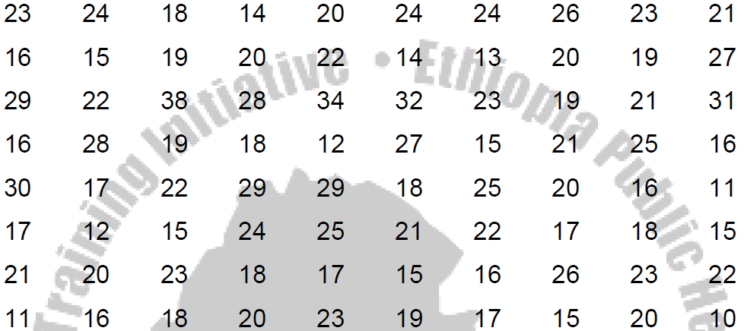
Example 2:
Construct a grouped frequency distribution of the following data on the amount of time (in hours) that 80 college students devoted to leisure activities during a typical school week:

Slide 18
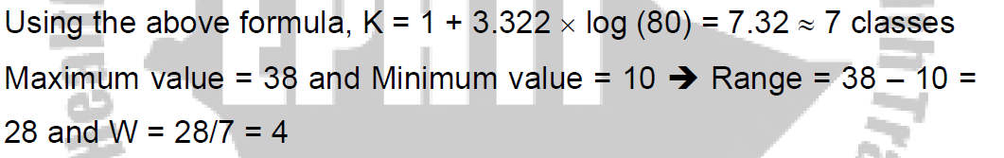
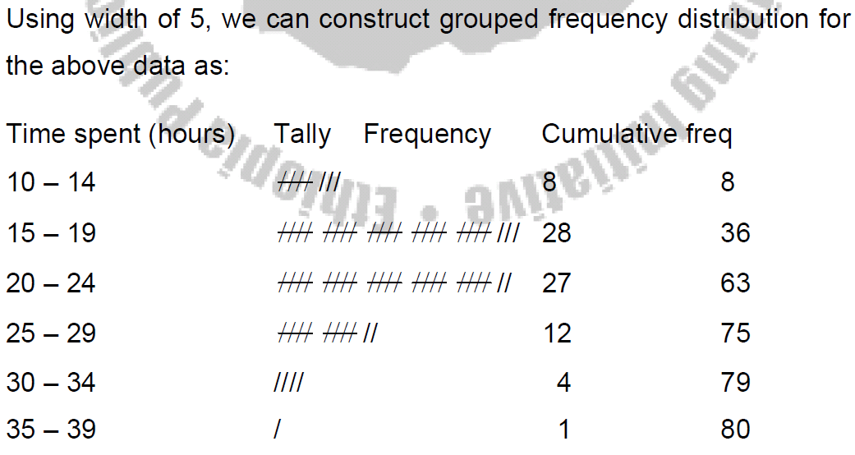

Slide 19
Thank You!!

